Slide 1


ONYX FITNESS
2023 FINANCIAL REPORT
Analyzing Our Growth Strategies
August 2024 Onyx Data Challenge
Presented by Dipsikha Das

Slide 2
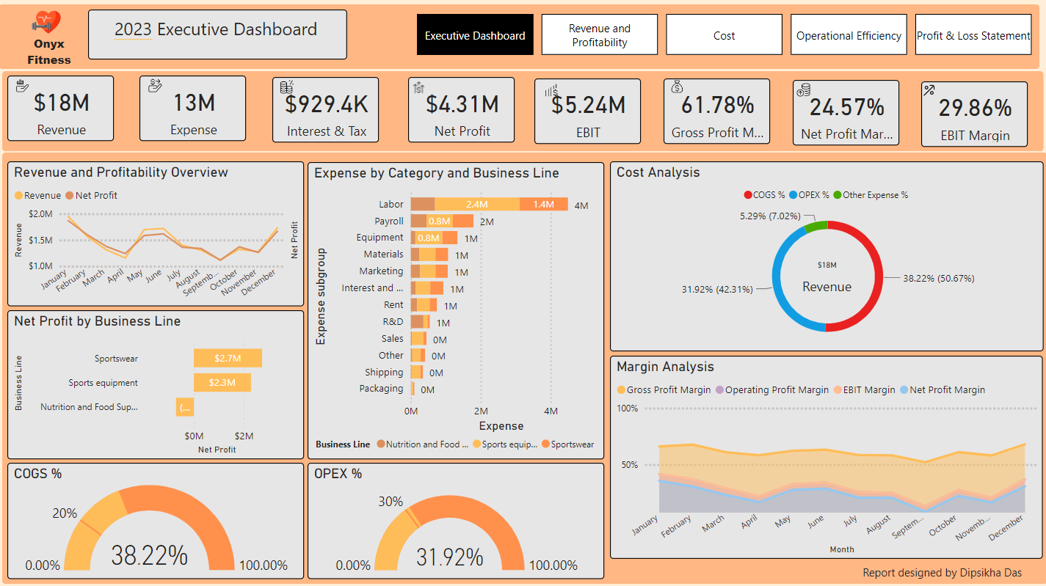

Slide 3
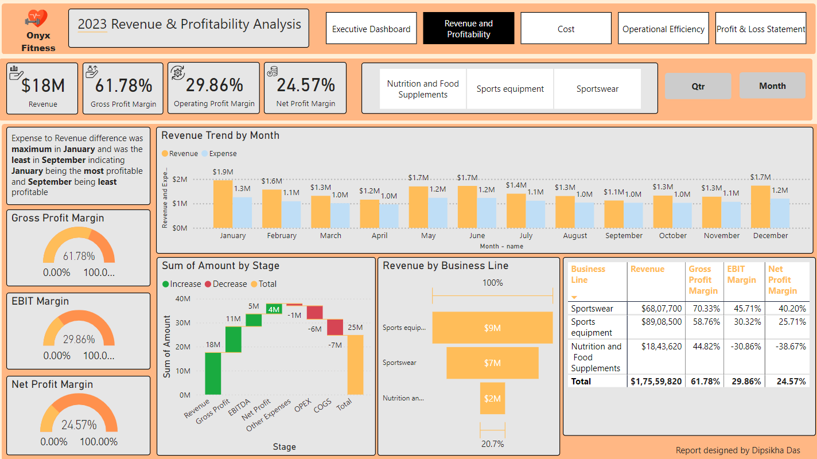

Slide 4
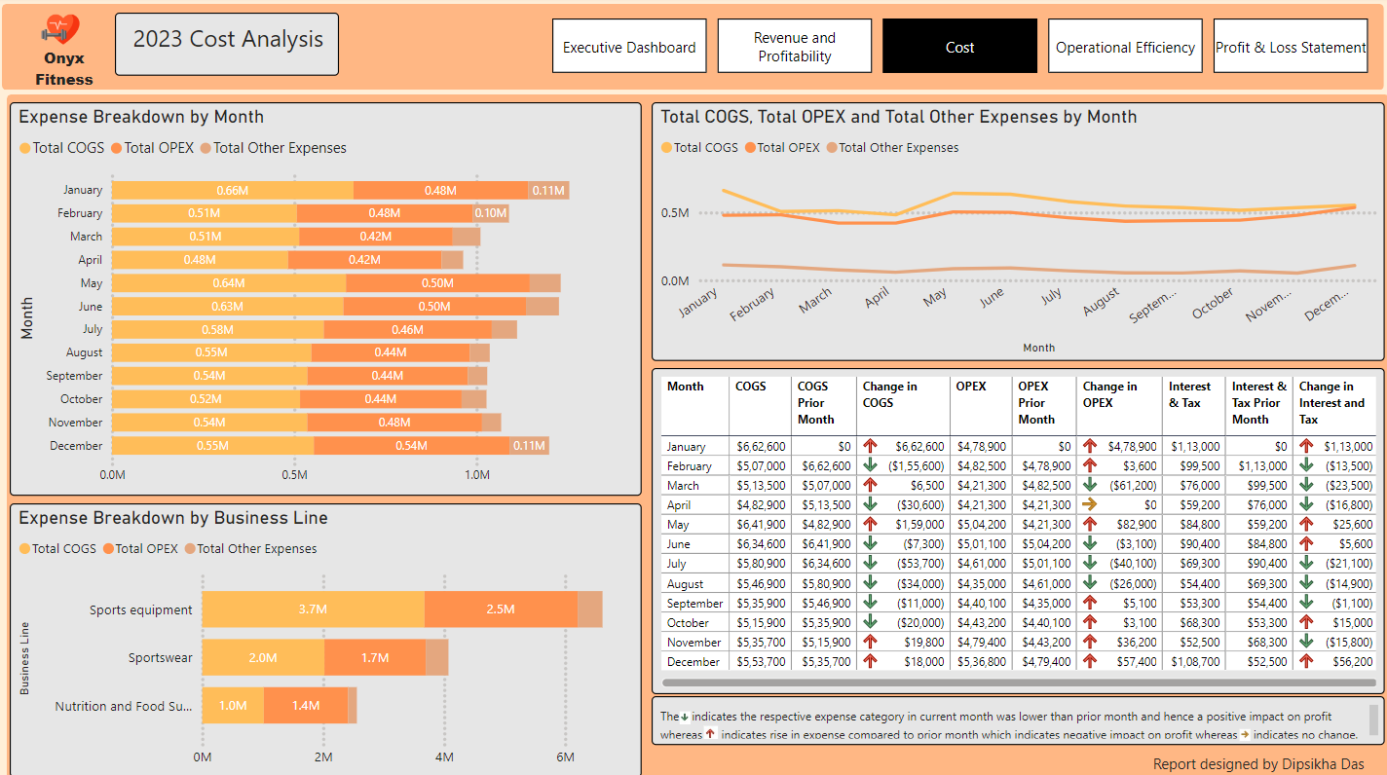

Slide 5
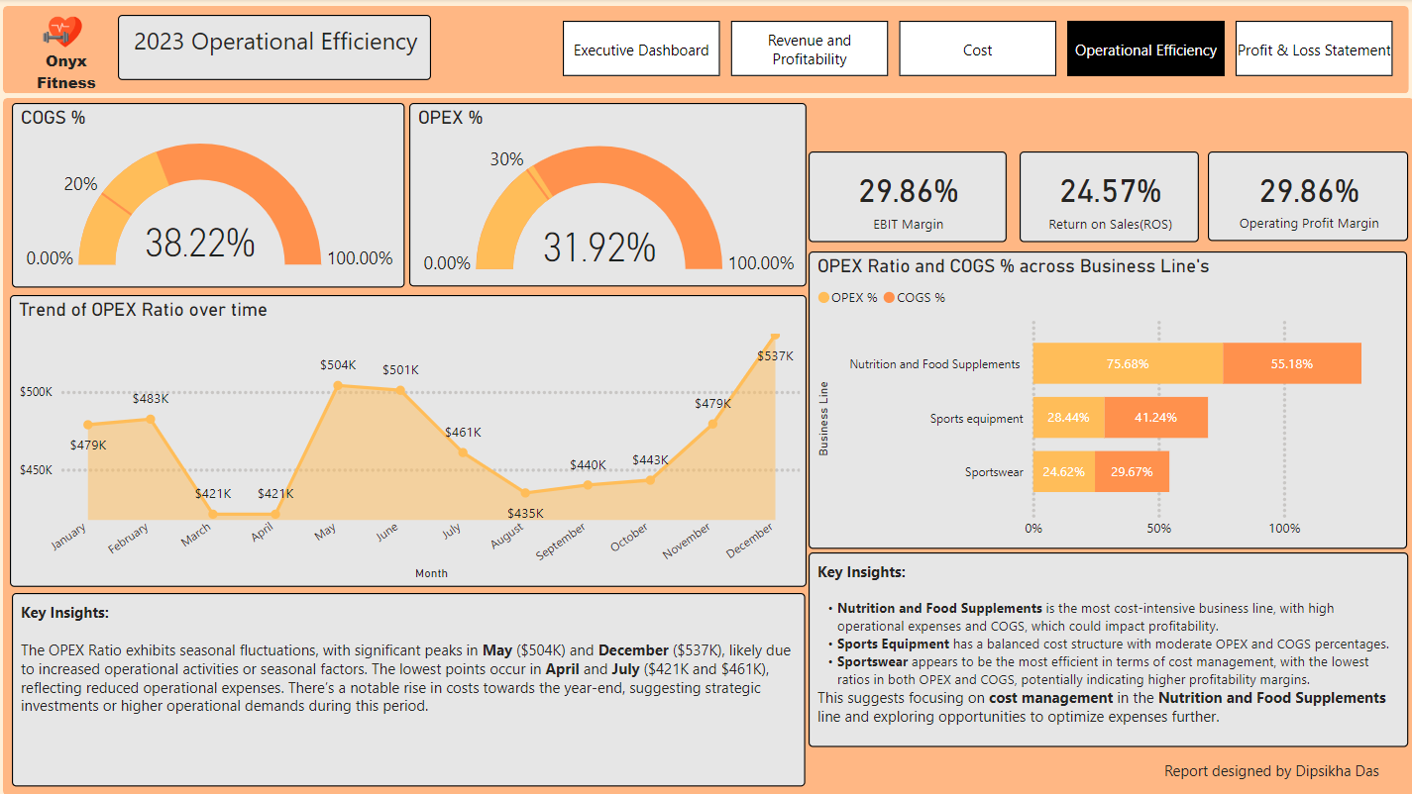

Slide 6
